Slide 1
Artificial Intelligence Club
Michael & Scott

Slide 2


Start
User Name
AIM
COMP
RESOURCES

Slide 3
THE AIMs OF THIS ECA
Evaluation
Learn about the theories of AI
Learn about programming
Classifier
Naïve Bayes
Decision tree -> random forest
KNN
support vector machine
Neural Network
Optimization
gradient descend
particle swarm optimization
reinforced learning
Simulate Anneal
NP/NP hard
Test hypothesis
data cleaning
imbalance data
accuracy / TPR / FNR
ROC curve
loss
python foundation
array 101
array pro
numpy
matplotlib
scikit-learn
tensorflow

Slide 4

Competitions
Hackerrank

Slide 5
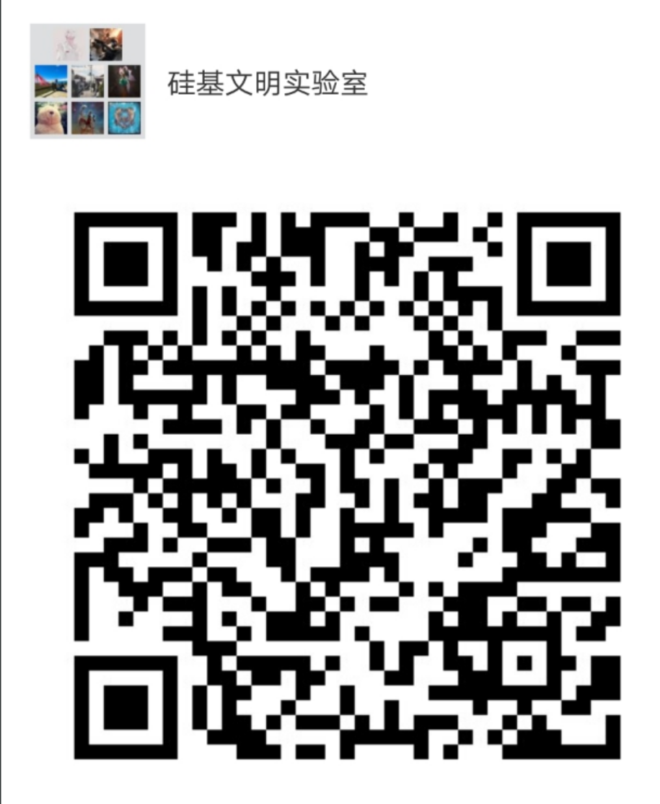
Resources
Club website
Linzexinmasterchief.github.io
Wechat group
internet
github
stackoverflow

Slide 6
Wish we could all have a good time together
{
}

